Slide 1

Welcome!
Please find your table
Introduce yourself
Meet the others
Nicky Phear
Mansfield Center Program Director
Davidson Honors College Faculty

Slide 2
Goals
Interact with others from different schools
Help solve a problem using ideas from InnovateHS and ideas from your own lives
Engage creatively, sharing and building off the ideas of others
Visualize the solutions that emerge from this group

Slide 3
Big Picture Problems
You’ll Address
HH: Health & Human Development
-- How can we improve mental health care and decrease suicide rates among youth?
ST: Science & Technology
-- How can we meet global energy demands while not contributing to global warming?
ES: Environment & Sustainability
-- How can we affordably eliminate single use plastics from our cities?
AC: Communication & Artistic Expression
-- How can art and communication be used to address political polarization in this country?
BE: Business & Entrepreneurship
-- How can we use technology to bring awareness to and address issues of inequality, such as sexual and racial discrimination?
JP: Justice, Policy & Public Service
-- How can we save lives from gun violence while protecting gun rights?

Slide 4
Innovation in
Action
Work as a group to generate 50 solutions
First 1-2 minutes, work alone, generate one or more ideas on a sticky note
Think as big as possible, also don’t be afraid to state what may feel obvious
Feel free to add both drawings
Involve everyone at your table
Facilitators can help if you get stuck
You have 20 minutes!

Slide 5
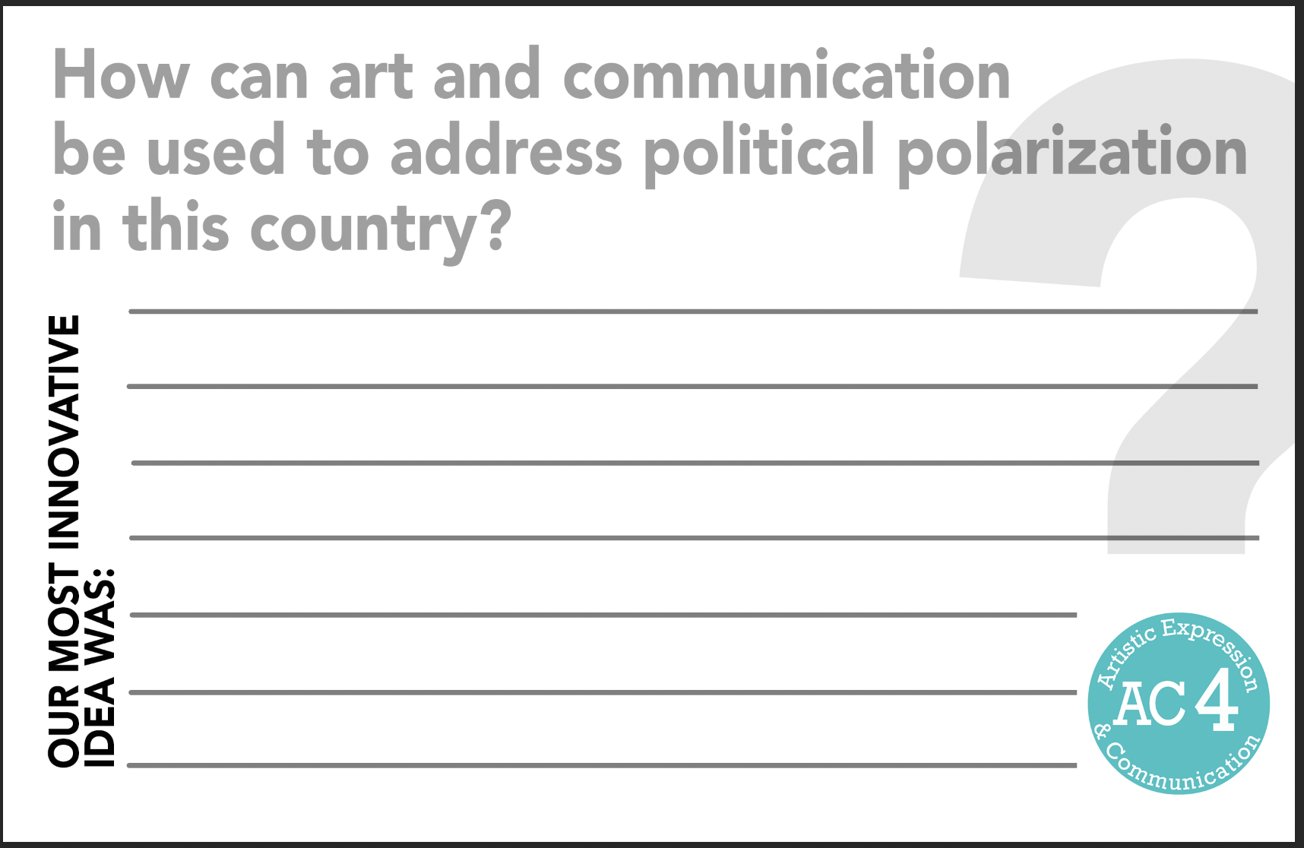


Slide 6
Innovation in Action
Identify your best solution
--Most useful/effective
--Most novel/unique
--Link ideas
Write down and share your ONE most innovative idea
Read others and vote for the one you like best
There will be a prize for the team with the most votes!

Slide 7
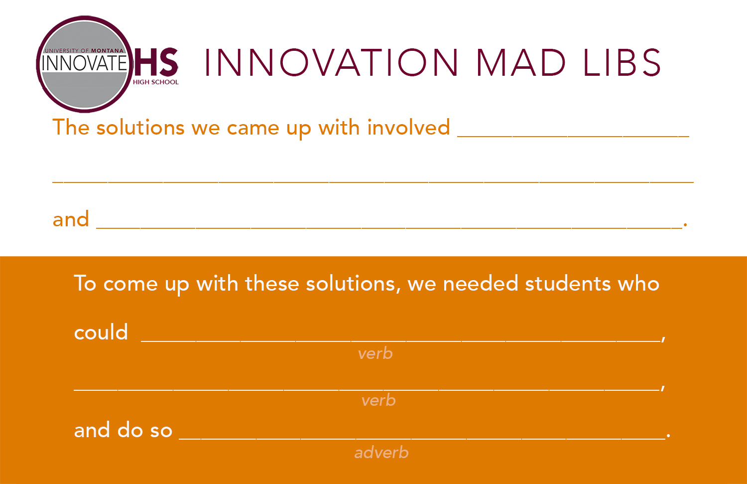

Slide 8

Korea Program
10-day tour
Fully funded for High School Juniors
Includes workshops and presentations in advance
Applications close October 25
Four spots!
Notes:
New opportunity for multicultural leadership and networking with the Project Bridge Korea program.
Fully funded program for HS juniors. No cost for students.
6 month academic enrichment program that consists of 8 US/Korea workshops, community presentations and a 10-day study tour of Korea.
Applications close October 25th. Everyone is encouraged to apply. Only four students will be chosen.

Slide 9


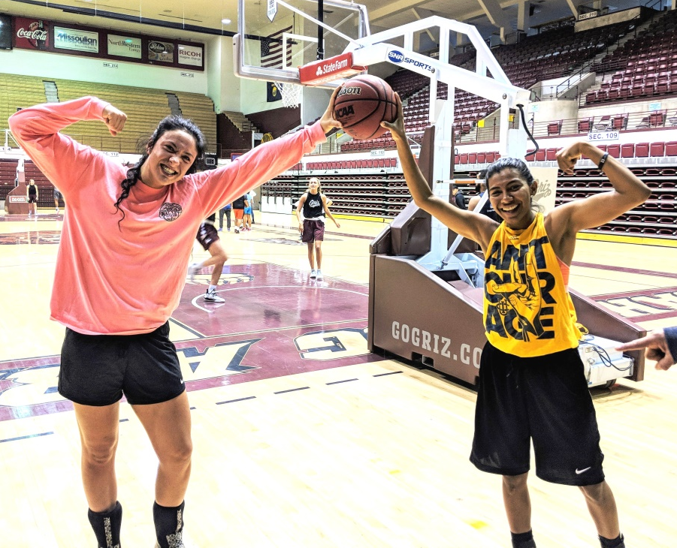
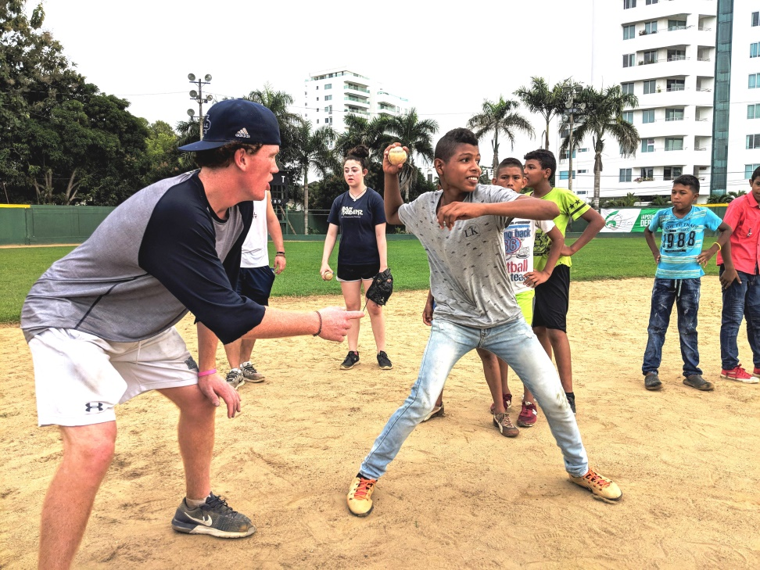
Sports Diplomacy
Be part of a team of athletes, coaches, and sports administrators who travel to Latin America on an all-expense-paid program funded by the U.S. Department of State to address critical global issues through sport.
Application information will be on umt.edu/mansfield in 2020.

Slide 10

Summer 2020:
June 16-26
for High School Students
UM credit
Scholarships available

Slide 11





Thank you for joining us today!
Please complete a short evaluation
Let us know if you want more information about any of these programs

